Slide 1

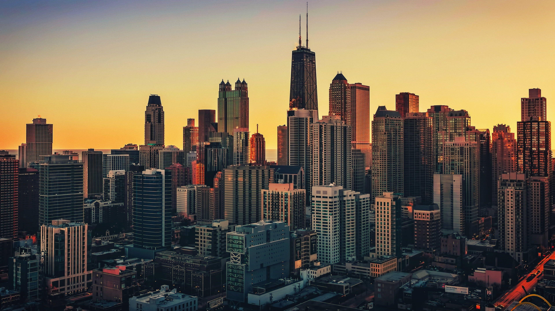
CITY DESIGN.
Designed by:
Vinay
Shashank
Sumit
Rahul
Notes:
null

Slide 2

CONTENTS
CITY PLAN LAYOUT.
Area distribution.
Population distribution.
Budget distribution.
Revenue models.
Sustainability.
Learnings from failed cities
Notes:
null

Slide 3
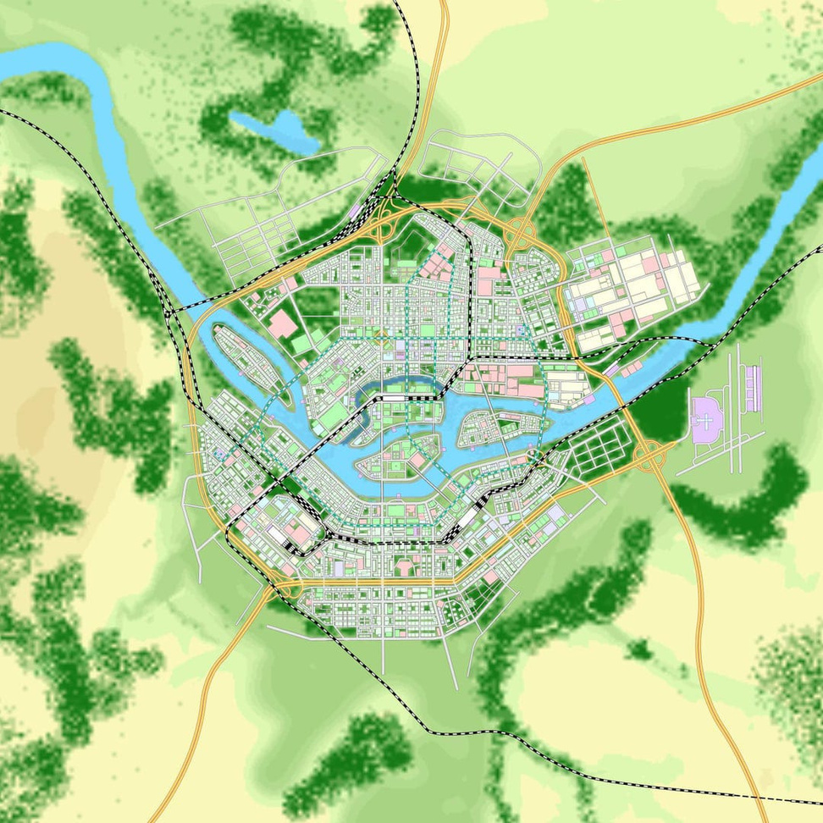
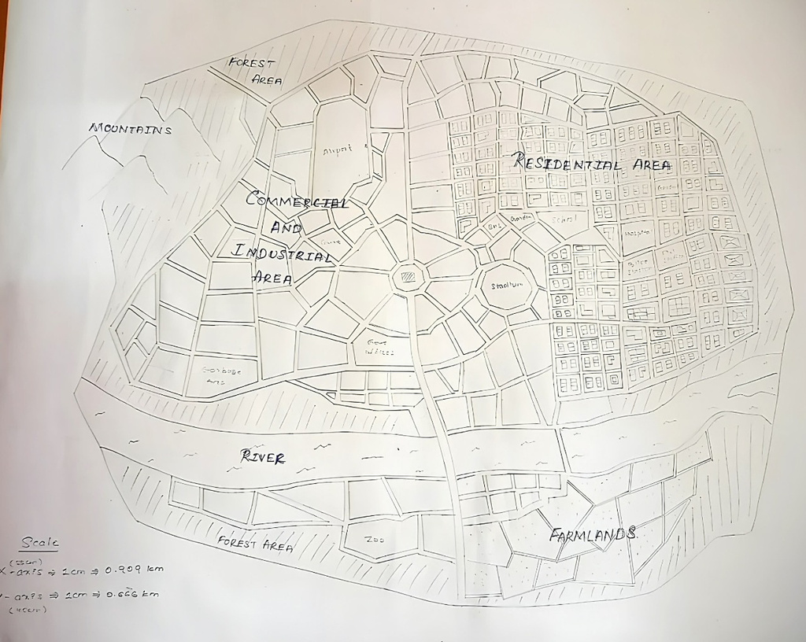
CITY PLAN LAYOUT:
Arimo
City Name: INDUS
Area: 1500sq. km
Pincode: 530069
Time zone: IST(+5:30)

Slide 4
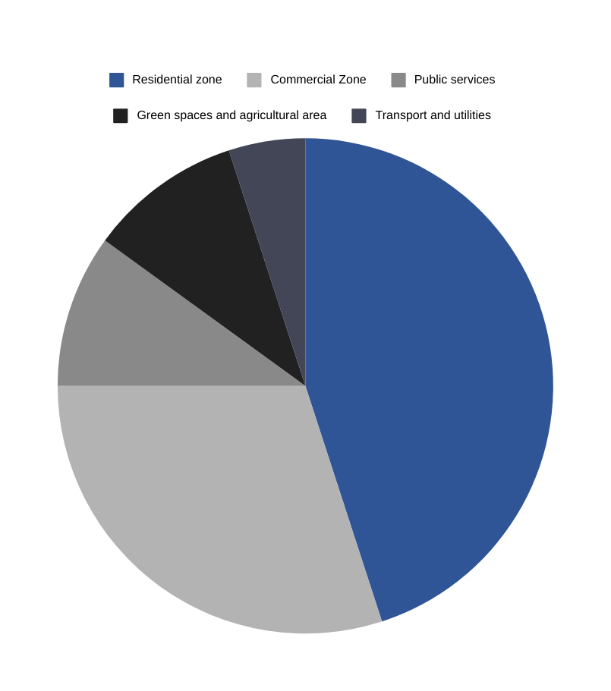
AREA DISTRIBUTION:
1.Residential Area: This covers over 45% of area which is ~675sq.km of total area .This includes houses, societies, apartments etc.
2.Commercial Area: This covers over 30% of area, which is ~450sq.km of total area. This includes markets, industries, malls, hotels etc
3.Public Services and institutional zone: This includes schools, hospitals, government offices and research institutes which covers 10% of area ie. 150sq.km
4.Green Spaces: This includes park, agricultural areas, zoos etc which covers around 10% of total area ie. 150sq.km
5.Transport and Utilities: This includes roads, railways, metros, energy infrastructure which covers around5% of total area ie
~75sq.km

Slide 5

POPULATION DISTRIBUTION:
The total area of over city INDUS is 1500sq kilometers and total population roughly estimates ~8000000 peoples.
The average population density per sq. kilometer is around
8333 peoples.
As the city is in INDIA, most of the population is between the ages 16 to 32 years. The younger population helps to create more jobs and encourage start ups.

Slide 6
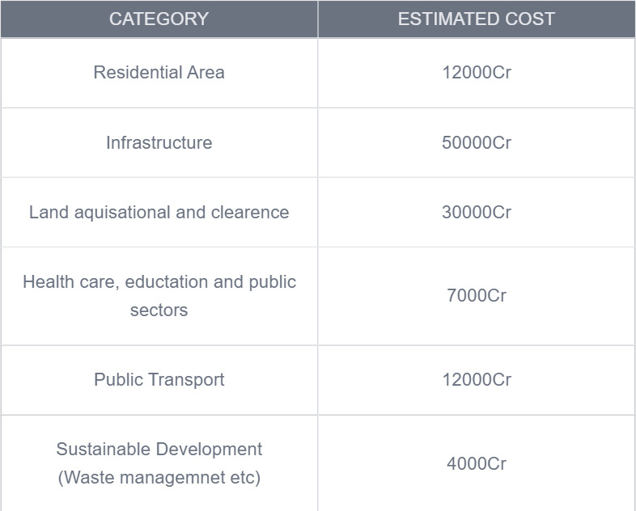
BUDGET DISTRIBUTION:
1.Residential Area: Constructions of houses, apartments etc
2.Commercial Area: constructions of commercial sectors and industries.
3.Public Services and institutional zone: This includes construction and management of public service sectors like courts, hospitals, schools etc
4.Green Spaces: This includes budget distribution in agricultural zones, wildlife area, parks etc
5.Transport and Utilities: This includes constructions of roads, highways, railway tracks and stations etc for transportation

Slide 7
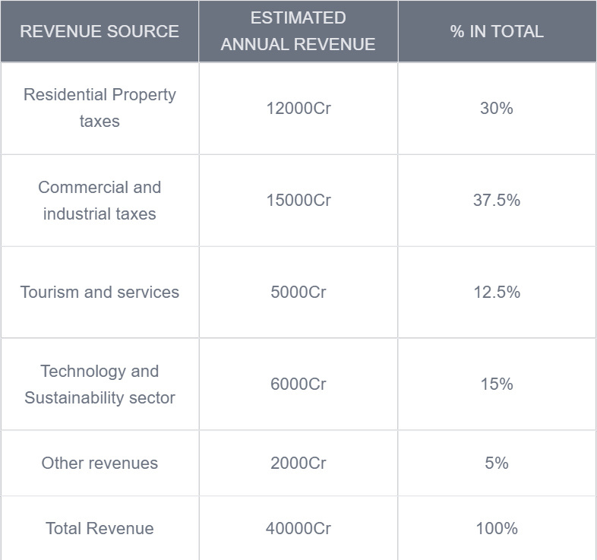
Revenue Model:
Residential property tax: This includes taxes on residenti areas which could generate around 12000Cr yearly ie.
30% of total revenue
2.Commercial and Industrial Taxes: This includes taxes from commercial zone buildings which could generate 15000Cr yearly ie 37.5% of total revenue.
3.Tourism and Infrastructure Servives: this includes the revenue generated from tourism and services which could generate around 5000Cr yearly ie 12.5%
4.Technology and Sustainability Sectors:
5.Other revenues: This may generate around 2000Cr yearly ie 5% of total revenue

Slide 8

Sustainability Plans:
Renewable Energy:
a)Solar Panels: This will be installed in residential and commercial area and can generate electricity which can be used by them.
b)Wind Turbines: Even this will generate electricity which can be utilised.
2.Water Management:
a)Rainwater Harvesting: This will help in conserving water.
b)Waste water Treatment plants: This will help in treatment of waste water from industries, resedential and commercial areas.
3.Forest Management: This will conserve the nearby forests saving the wildlife.

Slide 9
LEARNINGS FROM FAILED CITIES:
LAVASA:
-ISSUE: High upfront cost with poor long term planning and financial
managemnet.
-SOLUTION: Phased Development, Public Private Partnerships and sustainable
budgeting.
2.MASDAR:
-ISSUE: Over reliance on futuristic technologies, making city unaffordable.
-SOLUTION: Focus on scalable tevhnologies, ensuring affordability for residents
and prioritizing human centric services.

Slide 10
Thank You
Notes:
null

